Slide 1


Unit 3. Biodiversity and evolution history of animals

Slide 2
Public email for 2013
account: animal_biol_2013@126.com
password: whubio2013

Slide 3
Overview of Unit 3
Chapter 5. Classification and systematics of Animalia
Chapter 6. Protozoa
Chapter 7. Primitive multicellular animals
Chapter 8. Acoelomate triploblastic animals
Chapter 9. Pseudocoelomates
Chapter 10. Mollusca
Chapter 11. Annelida
Chapter 12. Arthropoda
Chapter 13. Echinodermata
Chapter 14. Characterisitics of chordata, Urochordata, Cephalochordata
Chapter 15. Pisces: fishes
Chapter 16. Amphibia
Chapter 17. Reptile
Chapter 18. Aves
Chapter 19. Mammalia

Slide 4
Chapter 5. Classification and systematics of Animalia
5.1 Basic concepts
5.2 A taxonomic hierarchy
5.3 Nomenclature
5.4 Approaches to animal systematics
5.5 Concepts in animal systematics (key)

Slide 5
5.1 Basic concepts
Systematics系统学: The study of the kinds and diversity of organisms and of the evolutionary relationships among them.
Taxonomy分类学：Extensive overlap between systematics and taxonomy, preferring to think of taxonomy as the work involved with the description of new species, while systematics as the assignment of species into evolutionary groups.
Phylogenetics系统发生学：the study of evolutionary relation among groups of organisms (e.g. species, populations), which is discovered through molecular and morphological data matrices.

Slide 6
5.2 A taxonomic hierarchy
Taxonomic hierarchy | Human
Domain域 | Eukarya真核生物域
Kingdom界 | Animalia动物界
Phylum门 | Chordata脊索动物门
Class纲 | Mammalia哺乳动物纲
Order目 | Primates灵长目、类人猿亚目
Family科 | Hominidae人科
Genus属 | Homo人属
Species种 | sapiens人种
Taxon: Any grouping of animals that shares a particular set of characterisitics
Forms an assemblage called a taxon (plural., taxa)

Slide 7
History of taxonomic hierarchy
1735, Linné’s two-kingdom system: Plantae, Animalia
1866, Haeckel’s three-kingdom system: Protista, Plantae, Animalia
1969, Whittaker’s five-kingdom: Monera, Protista, Plantae, Fungi, Animalia
1979, 陈世骧: three-superkingdom and six-kingdom system
Bacteria, Cyanobacteria (Monera), Plantae, Fungi, Animalia (Eukarya),
Viruses (Non-cellular life)
1980, Woese and Fox’s three-domain system: Archaea, Eubacteria, Eukarya
1990. Woose and Brusca’s additional six-kingdom system
- Eubacteria, Archaea, Protista, Plantae, Fungi, Animalia

Slide 8
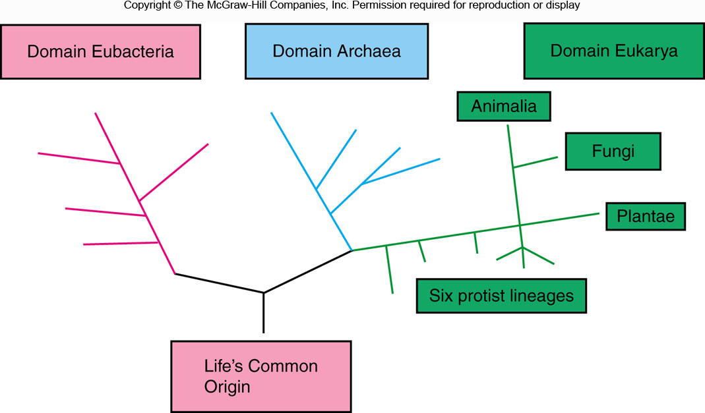
Commonly used three-kingdom system

Slide 9
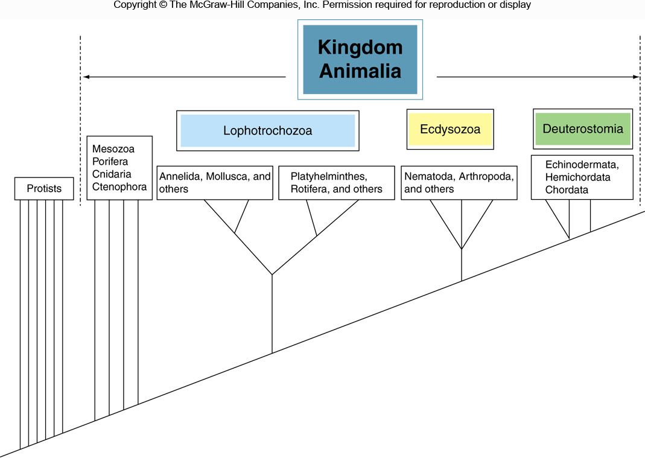
Higher animal taxonomy

Slide 10
5.3 Nomenclature
Nomenclature命名法：The assignment of a distinctive name to each species.
Binomial system双名法：Genus + species. e.g. Homo sapiens or H.sapiens. Genus + species +定名人的姓. For example, Ctenoptilum vasava Moore
Trinomial system三名法：Genus+species+ subspecies. e.g. Canis lupis familiaris

Slide 11
5.4 Approaches to animal systematics
Artificial classification: an arrangment based on convenience or arbitrary criteria, not representing true natural relations among species.
Natural classification: based on different degrees of relatedness among species, representing true natural relations.

Slide 12
Approaches to natural classification based on data types
Classical taxonomy: morphological characters
External morphology (flower, seed, feather); internal structure (comparative anatomy); developmental pattern; ecology and behavior (nesting, singing, displaying, feeding).
Modern taxonomy: cytology (karyotypes, banding patterns of chromosome); immune reaction; structure and function of macromolecules (genes, proteins).
Assumption: When zoologists classify animals into taxonomic groupings, we are making hypotheses about the extent to which groups of animals share genes and proteins.

Slide 13
Approaches to natural classification based on methodological types
Evolutionary systematics (traditional approach): a branch of biological classification that seeks to classify organisms using a combination of phylogenetic relationship and degree of evolutionary changes. Basic assumption is that organisms closely related to an ancestor will resemble that ancestor more closely. (homology vs. analogy)
Phylogenetic systematics (cladistics): the science of phylogenetics and its methods

Slide 14
Structure and function of macromolecules
Isoenzyme or isozyme同工酶
Protein sequences
Mitochondrial DNA
Nuclear DNA: coding or noncoding sequences
Ribosome RNA genes

Slide 15
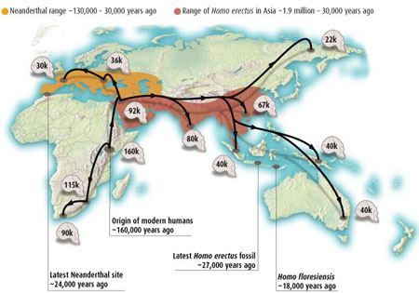
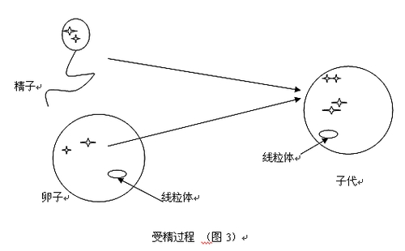
Mitochondrial DNA
Widely used in studying taxonomic relationships
Mitochondria have their genetic systems and are inherited
cytoplasmically
Therefore, mitochondria are transmitted from parent to
offspring through the egg cytoplasm and can be used to trace
maternal lineages

Slide 16

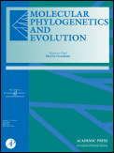
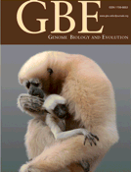
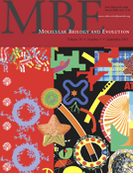
Main scientific journals that publish
molecular phlyogenetics and evolution

Slide 17
Take-home message
Molecular techniques will NOT
replace traditional taxonomic
methods

Slide 18
5.5 Concepts in animal systematics
1. Character / trait: anything that has a genetic basis and can be measured from an anatomical feature to a sequence of DNA or RNA.
2. Phenotype: an organism's observable characteristics or traits, such as its morphology, development, biochemical or physiological properties, phenology, behavior, and products of behavior (such as a bird's nest). Phenotypes result from the expression of an organism's genes as well as the influence of environmental factors and the interactions between the two.
3. Genotype: genetic makeup of a cell, an organism, or an individual usually with reference to a specific character or trait under consideration.

Slide 19
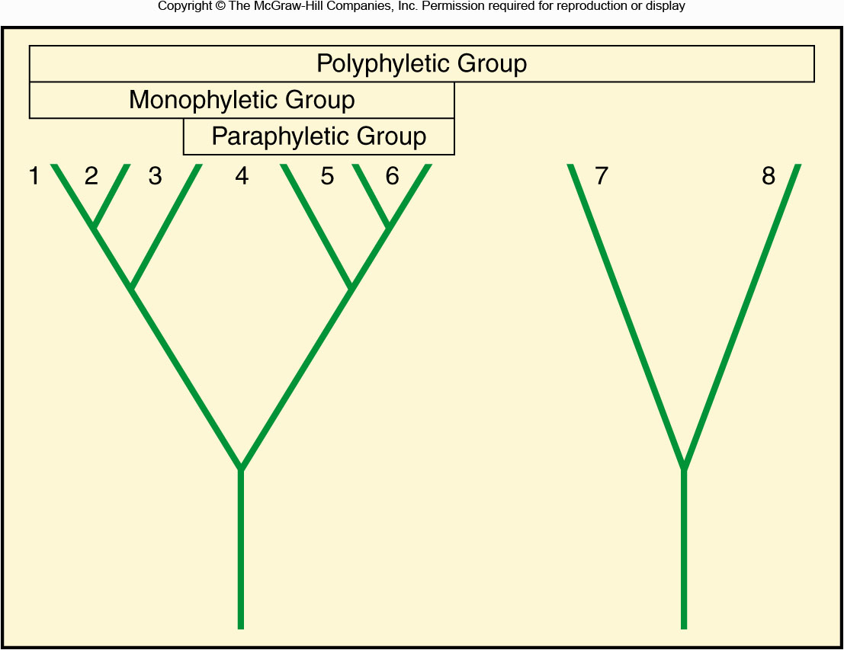
Evolutionary groups
4. Monophyletic group: includes a single ancestral species and all of its
descendants.
5. Paraphyletic group: includes some, but not all, members of a lineage.
6. Polyphyletic group: includes members that can be traced to separate ancestors.

Slide 20
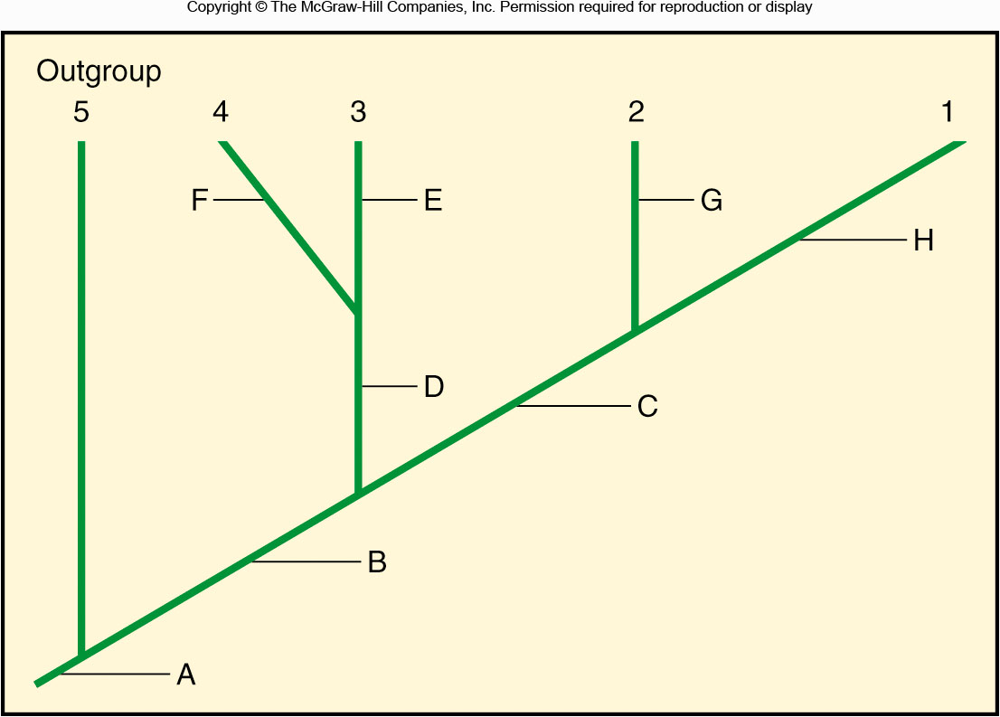
Interpreting cladograms
Symplesiomorphy
Synapomorphy
7. Ancestral character祖先性状: old characters that have been retained from a common ancestor.
8. Symplesiomorphy共同祖征: common characters in a group.
9. Derived character衍生性状: recently arised characters
10.Synapomorphy共同衍征: derived characters shared by a group
11.Outgroup: a related group that is not included in the study group
12.Ingroup: study group

Slide 21
Chapter 6. Protozoa
6.1 Evolutionary status
6.2 Composition of a protozoan
6.3 Symbiotic lifestyle
6.4 Protozoan taxonomy (key)

Slide 22
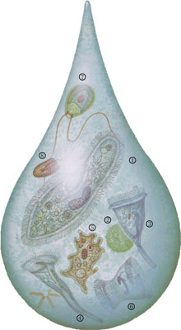
Protozoan animals found from
a drop of pond water
1.草履虫
2.团藻
3.钟形虫
4.喇叭虫
5.变形虫
6.毛口虫
7.单胞藻
8.唇滴虫

Slide 23
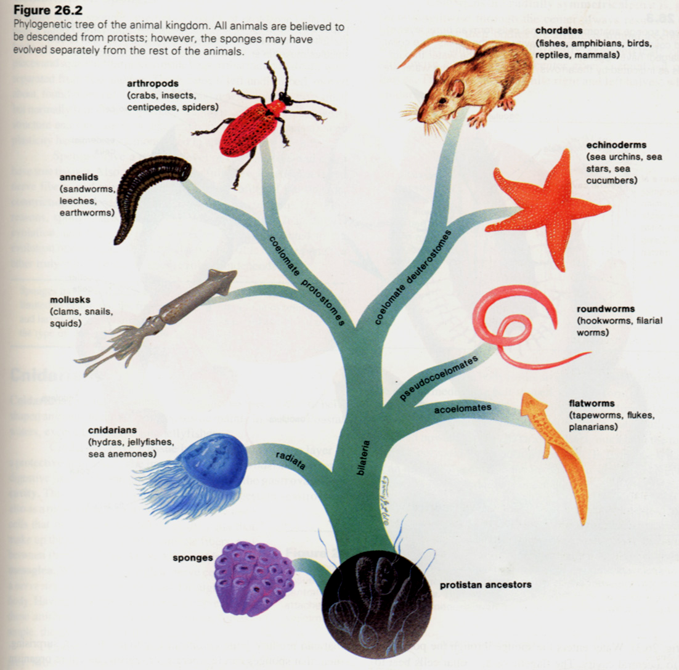
6.1 Evolutionary status
Protozoa 原生动物门
Spongia 海绵动物门
Coelenterata 腔肠动物门
Platyhelminthes 扁形动门
Pseudocoelomates假体腔动物
Annelida 环节动物门
Mol1usca 软体动物门
Arthropoda 节肢动物门
Echinodermata 棘皮动物门
Chordata 脊索动物门

Slide 24
Protozoans
The most ancient, primitive single-celled eukaryotes;
The whole body is a cell and the single cell is an independent, complete organism;
There are many kinds of organelles, and all life activities are carried out within a single plasma membrane;
It is more complex than any particular cell in higher organisms.

Slide 25
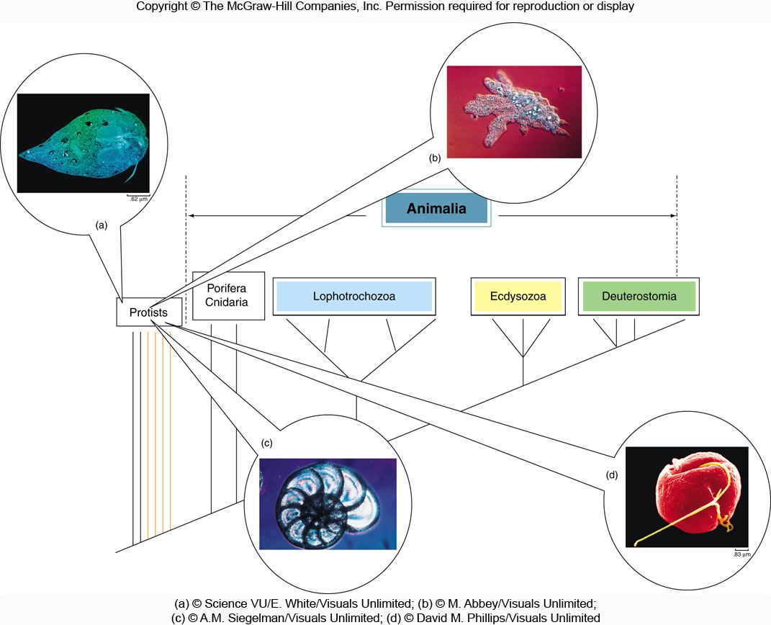
Amoebozoa变形虫类
Excavata古虫类
Rhizaria有孔虫类
Chromalveolata囊泡藻类
The challenge of protist classification

Slide 26
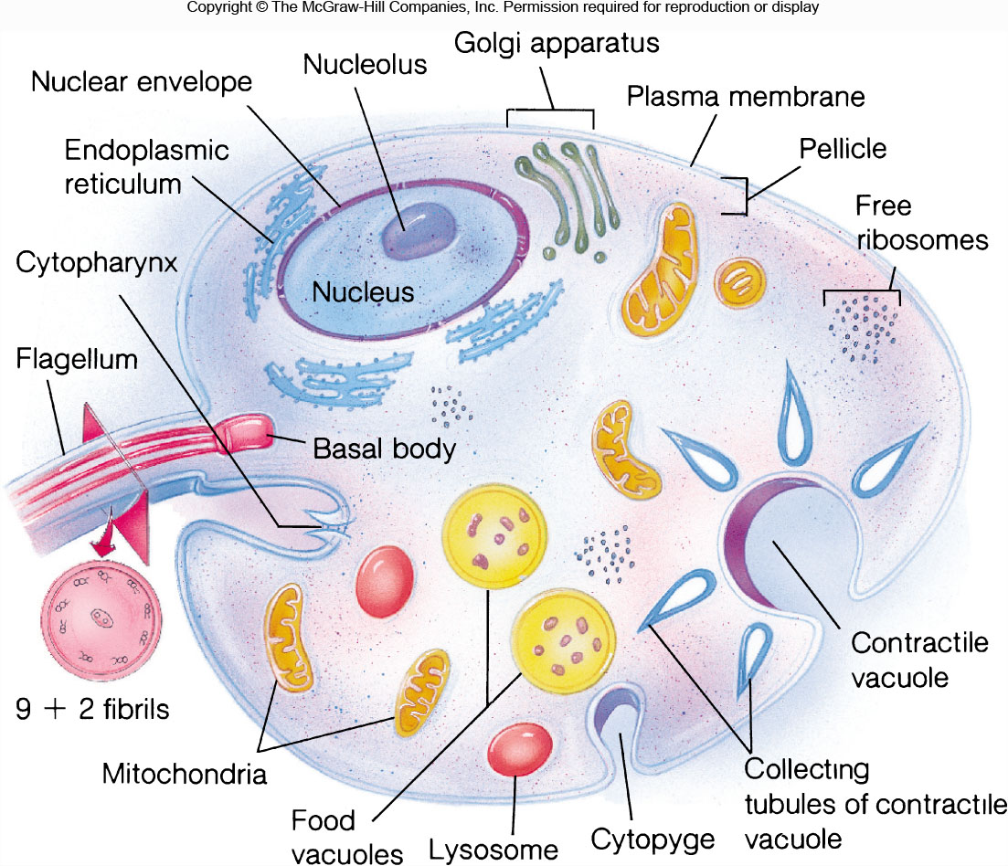
6.2 Composition of a protozoan
薄膜
吞噬泡
胞肛

Slide 27
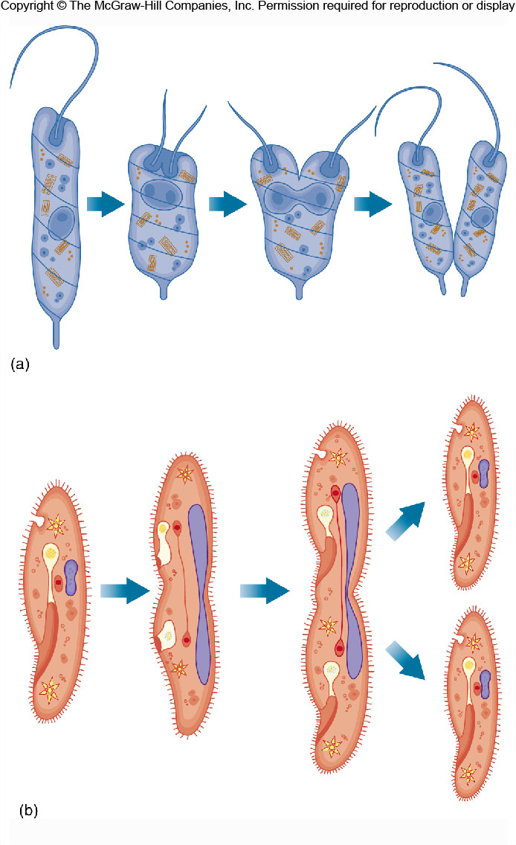
Mostly asexual reproduction in Protozoa
Longitudinal binary fission
(e.g., euglenoids)
Transverse binary fission
(e.g., ciliates)

Slide 28
6.3 Symbiotic lifestyle
Many protozoa have symbiotic lifestyles.
Concepts:
(1) Parasitism: interactions involving a form of symbiosis.
(2) Host: an organism that another organism (parasite) lives in or on.
(3) Definitive host: harbors the sexual stages of the parasite
(4) Intermediate host: additional host
(5) Commensalism共生: a symbiotic relationship in which one member benefits, and the second is neither benefited nor harmed.
(6) Mutualism互利共生：a symbiotic relationship in which both species benefit.

Slide 29
6.4 Protozoan taxonomy
SUPER GROUP | FEATURES | FIRST RANK | EXAMPLES
Excavata | Flagellum | Fonnicata | Giardia梨形鞭毛虫
古虫类 |  | Parabasalia | Trichomonas毛滴虫
 |  | Euglenozoa | Euglena
 |  | (领鞭毛虫） | Choanoflagellates
Amoebozoa | Pseudopodia | Tubulinea | Amoeba
变形虫类 |  | Acanthamoebidae
 |  | Entamoebida
Rhizaria | Pseudopodia | Foraminifera
有孔虫类 |  | Radiolaria
Chromalveolata |  | Alveolata | Ciliophora (ciliates)
囊泡藻类 |  | （鞭毛藻类） | Dinoflagellates

Slide 30
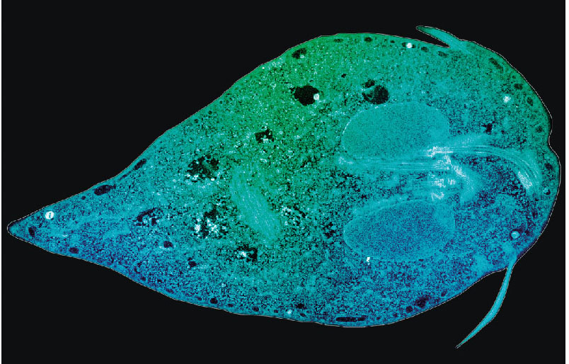
Representative protozoans
The protozoan Giardia. This parasite causes the water-borne disease
giardiasis梨形鞭毛虫病 in animals and humans.

Slide 31
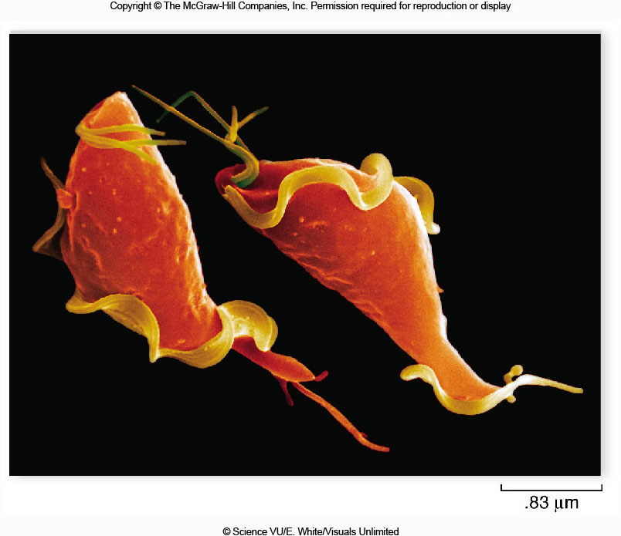
Figure 8.06
The protozoan Trichomonas vaginalis. This parasite causes the sexually transmitted disease trichomoniasis in humans.

Slide 32
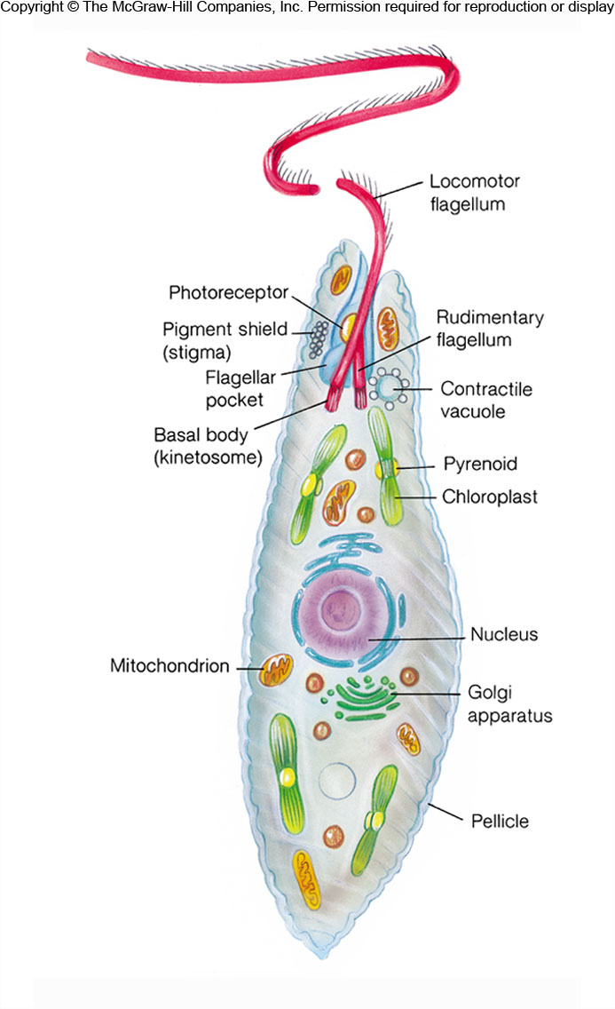
The structure of
Euglena绿眼虫
蛋白核

Slide 33
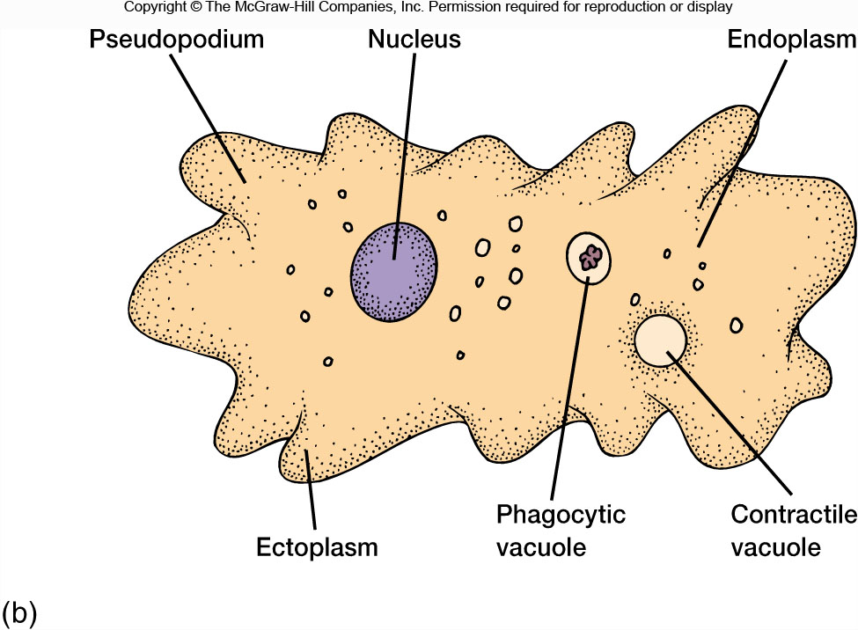
Figure 8.10b
吞噬泡
Anatomy of an amoebozoan

Slide 34
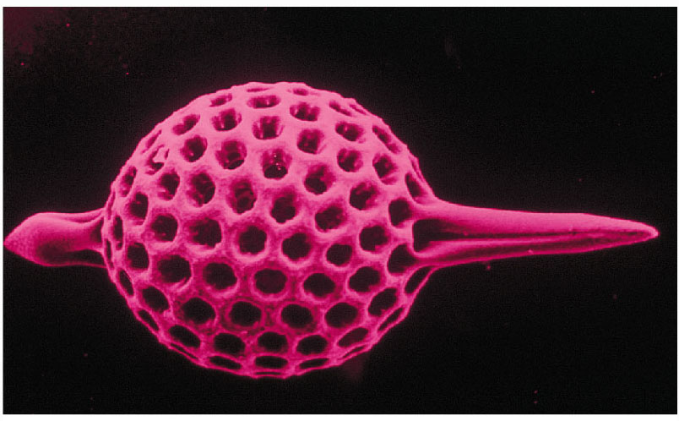
Figure 8.13b
Test of a species of Rhizaria

Slide 35
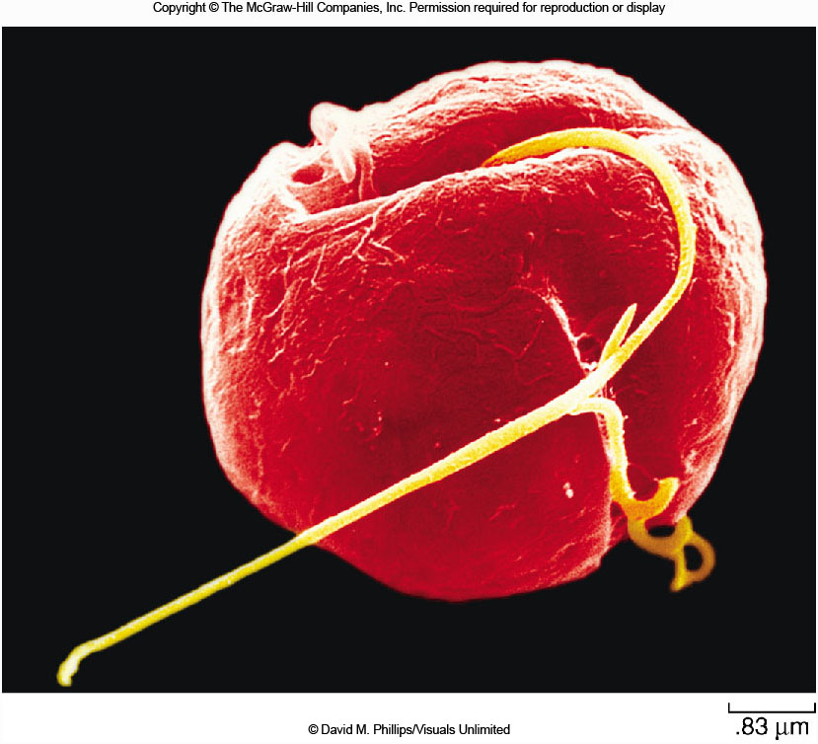
Figure 8.14
A Dinoflagellate腰鞭毛虫. Large numbers of them can color
the sea red and produce toxins that result in large fish kills.

Slide 36
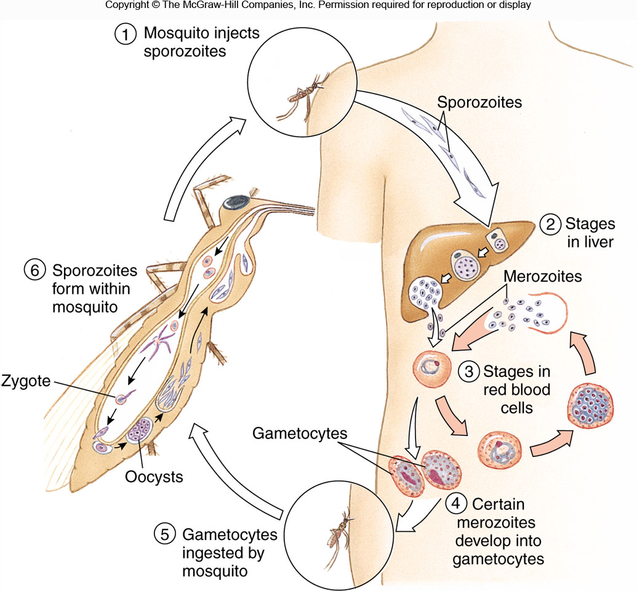
Figure 8.15
孢子体
裂殖体
配子体
The life cycle of Plasmodium疟原虫

Slide 37
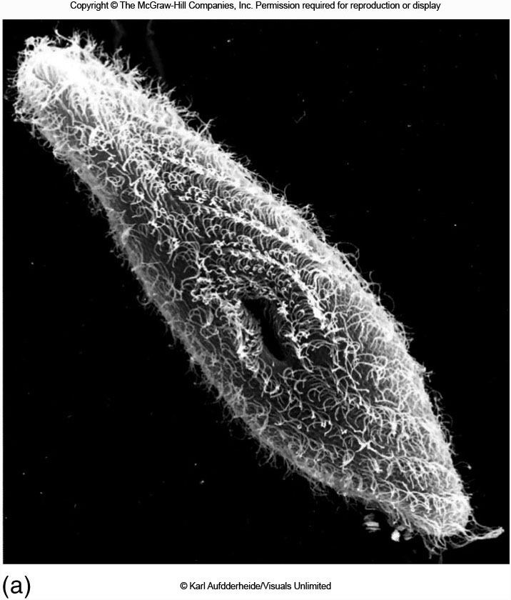
Figure 8.16a
The ciliate Paramecium sonneborn

Slide 38
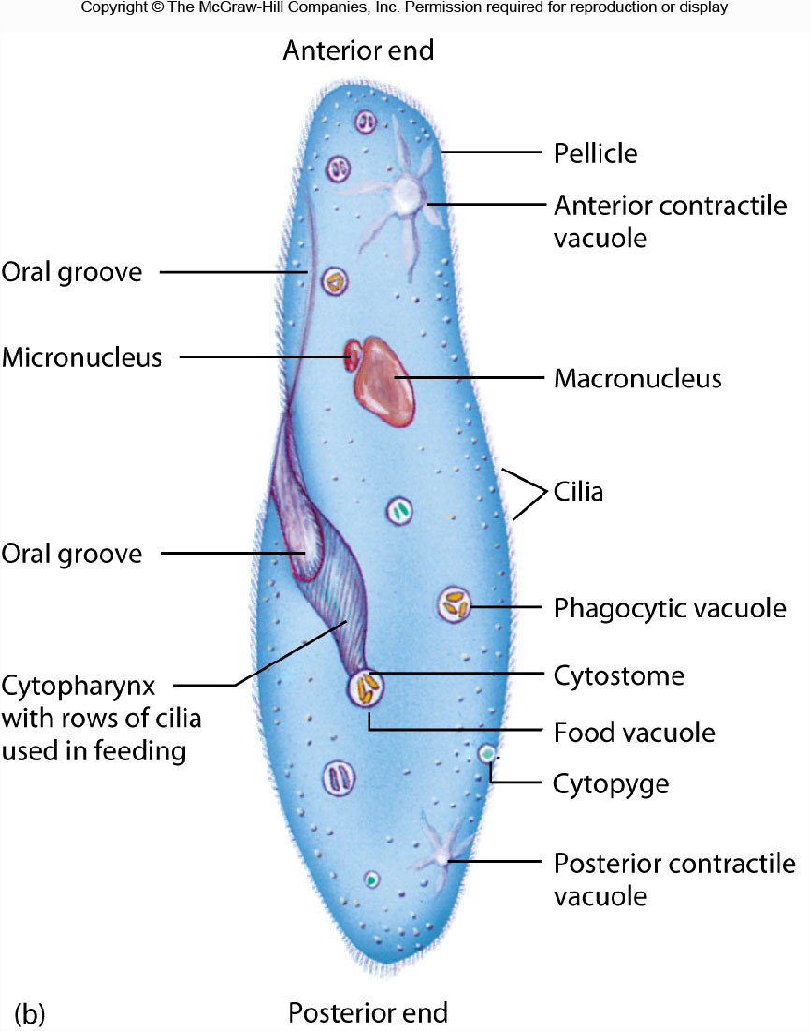
胞咽
入口孔
胞肛
The ciliate Paramecium sonneborn

Slide 39
Next Lecture
Chapter 7. Primitive multicellular animals
Chapter 8. Acoelomate triploblastic animals

